Slide 1
Stochastic Games in AI

Slide 2
Properties Stochastic Games?
What is Stochastic?
Opposite of Deterministic.
Next State of Environment not Determined from Current state.
Environment is partially Observable.
Random element.
Unpredictable.
Single or Multiple Agents.
Sequential Decision making.

Slide 3
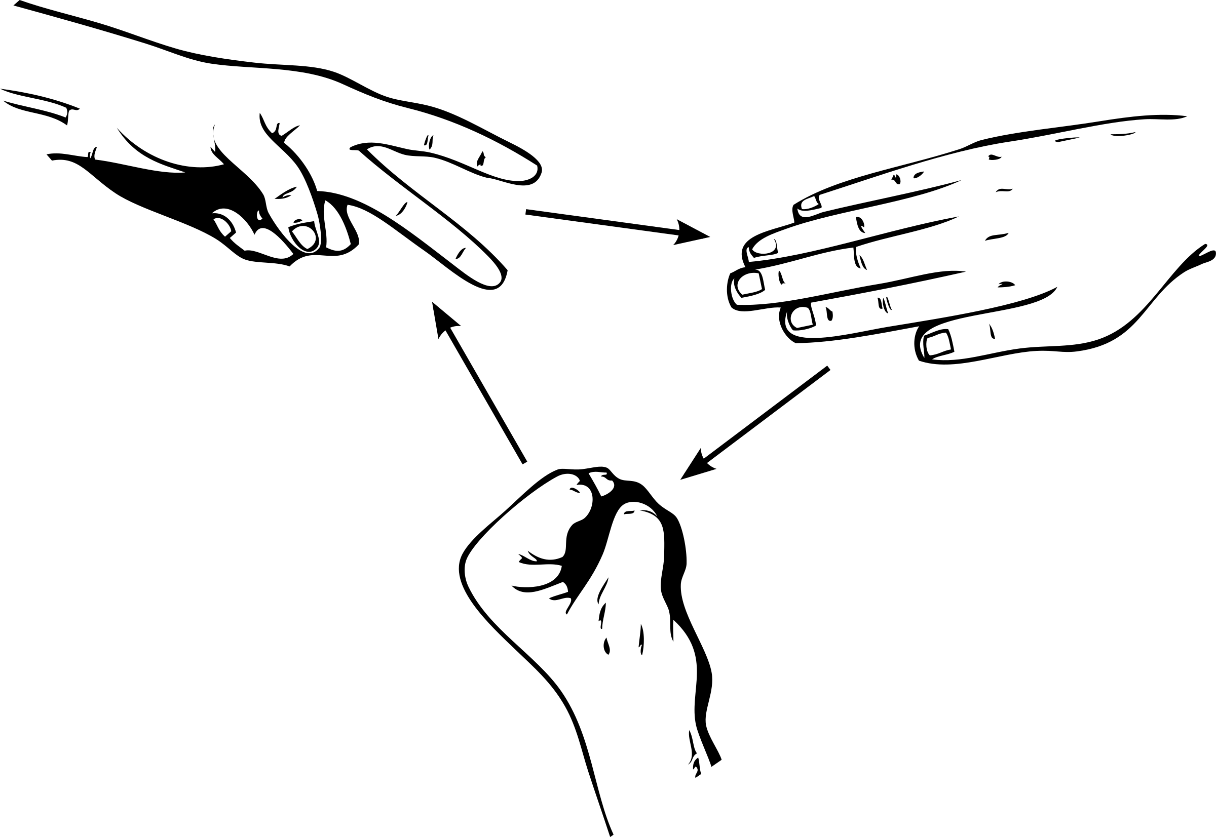
Example: Rock Paper Scissors
Players: Two players, Player A and Player B.
Actions: Each player can choose one of three actions:
Player A: Rock (R), Paper (P), or Scissors (S).
Player B: Rock (R), Paper (P), or Scissors (S).

Slide 4
Payoffs: The payoffs depend on the combination of choices made by both players:
If both players choose the same action, the payoff is zero for both (tie).
Rock beats Scissors, Scissors beat Paper, and Paper beats Rock
State Transition: The transition between states depends on the actions chosen by each player in the previous round.
Strategy: Each player aims to maximize their expected payoff.

Slide 5
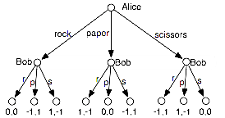
Tree Representation:

Slide 6
Applications in AI
Reinforcement Learning (Payoffs)
Multi-agent systems and strategic decision-making
Real-world applications
Autonomous driving
Robotics
Stock Market

Slide 7
Limitation of Stochastic Games
Complexity and Computational Intensity.
Limited Predictive Power.
Scalability Issues.
Limited Real-World Data

Slide 8
Thankyou

